Slide 1
Standardizing Business Architecture
Austin, Texas, USA - September 15, 2014
William Ulrich, Business Architecture Guild & TSG, Inc.
Janice Lewis, Pfizer
www.businessarchitectureguild.org

Slide 2
Standardizing business architecture?
Why standardization?
What is standardization?
Path to phased standardization
Long-term game plan

Slide 3
Why Standardization?
Too many misaligned business architecture perspectives cause confusion, implementation slowdown and justification challenges
Tool vendor solutions do not fully align to standard mapping approaches, confusing teams and slowing deployments
Tool interchange makes sharing business architecture information across tools challenging
Executives sense that business architecture is not ready for prime time as no consistent deployment approach is in place
Lack of standardization harms progress towards a maturity industry

Slide 4
What is standardization?
Consistency of blueprint perspectives, including shared set of practice oriented principles
Agreed approach as to how all of the parts of business architecture align, with cross-mappings an essential aspect of the discipline
For example, value stream / capability cross-mapping provides insights not achieved from value streams or a capability map alone
An aligned body of knowledge with tool vendor solutions
A basis for formalizing artifact relationships that enables automation and dissemination of business architecture – the “metamodel”
A fully packaged standard, including metamodel, that has been passed officially by an international standards body

Slide 5
Path to Business architecture standardization
Formalize the discipline in a body of knowledge (i.e., BIZBOK® Guide)
Build collaborative consensus on approach through practice and practitioner contributions, including scenario development
Incorporate alignment to related disciplines, including BPM and requirements analysis
Build third party vendor support
Assemble artifacts and relationships into a formal metamodel
Package metamodel for submission to standards body*
Establish evolutionary path to build upon the standard long-term
* The Object Management Group (OMG®) is an international, open membership, not-for-profit technology standards consortium. www.omg.org

Slide 6
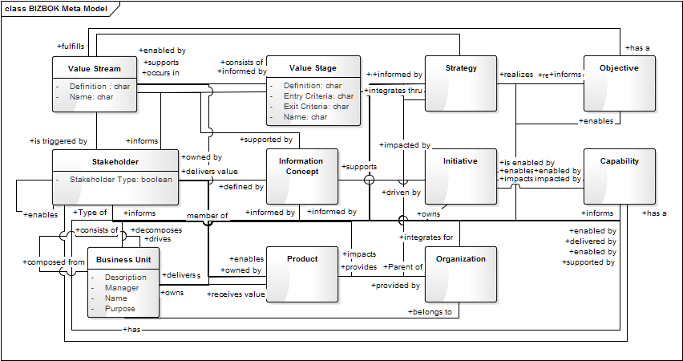
Sample Business architecture metamodel
* Source: A Guide to the Business Architecture Body of Knowledge™ (BIZBOK® Guide), V4.0, Part 5
Source: A Guide to the Business Architecture Body of Knowledge™ (BIZBOK®) Version 4.0

Slide 7

What value does standardization provide?
Tool-to-tool interchange via business architecture metadata
Consistency of artifact relationships ensures that tool based results easily align to best practices and industry body of knowledge
Consider the challenges of using a tool that does not enable the artifact input and blueprint production required for basic or extended business architecture perspectives, including automatic generation of standard mappings and cross-mappings

Slide 8

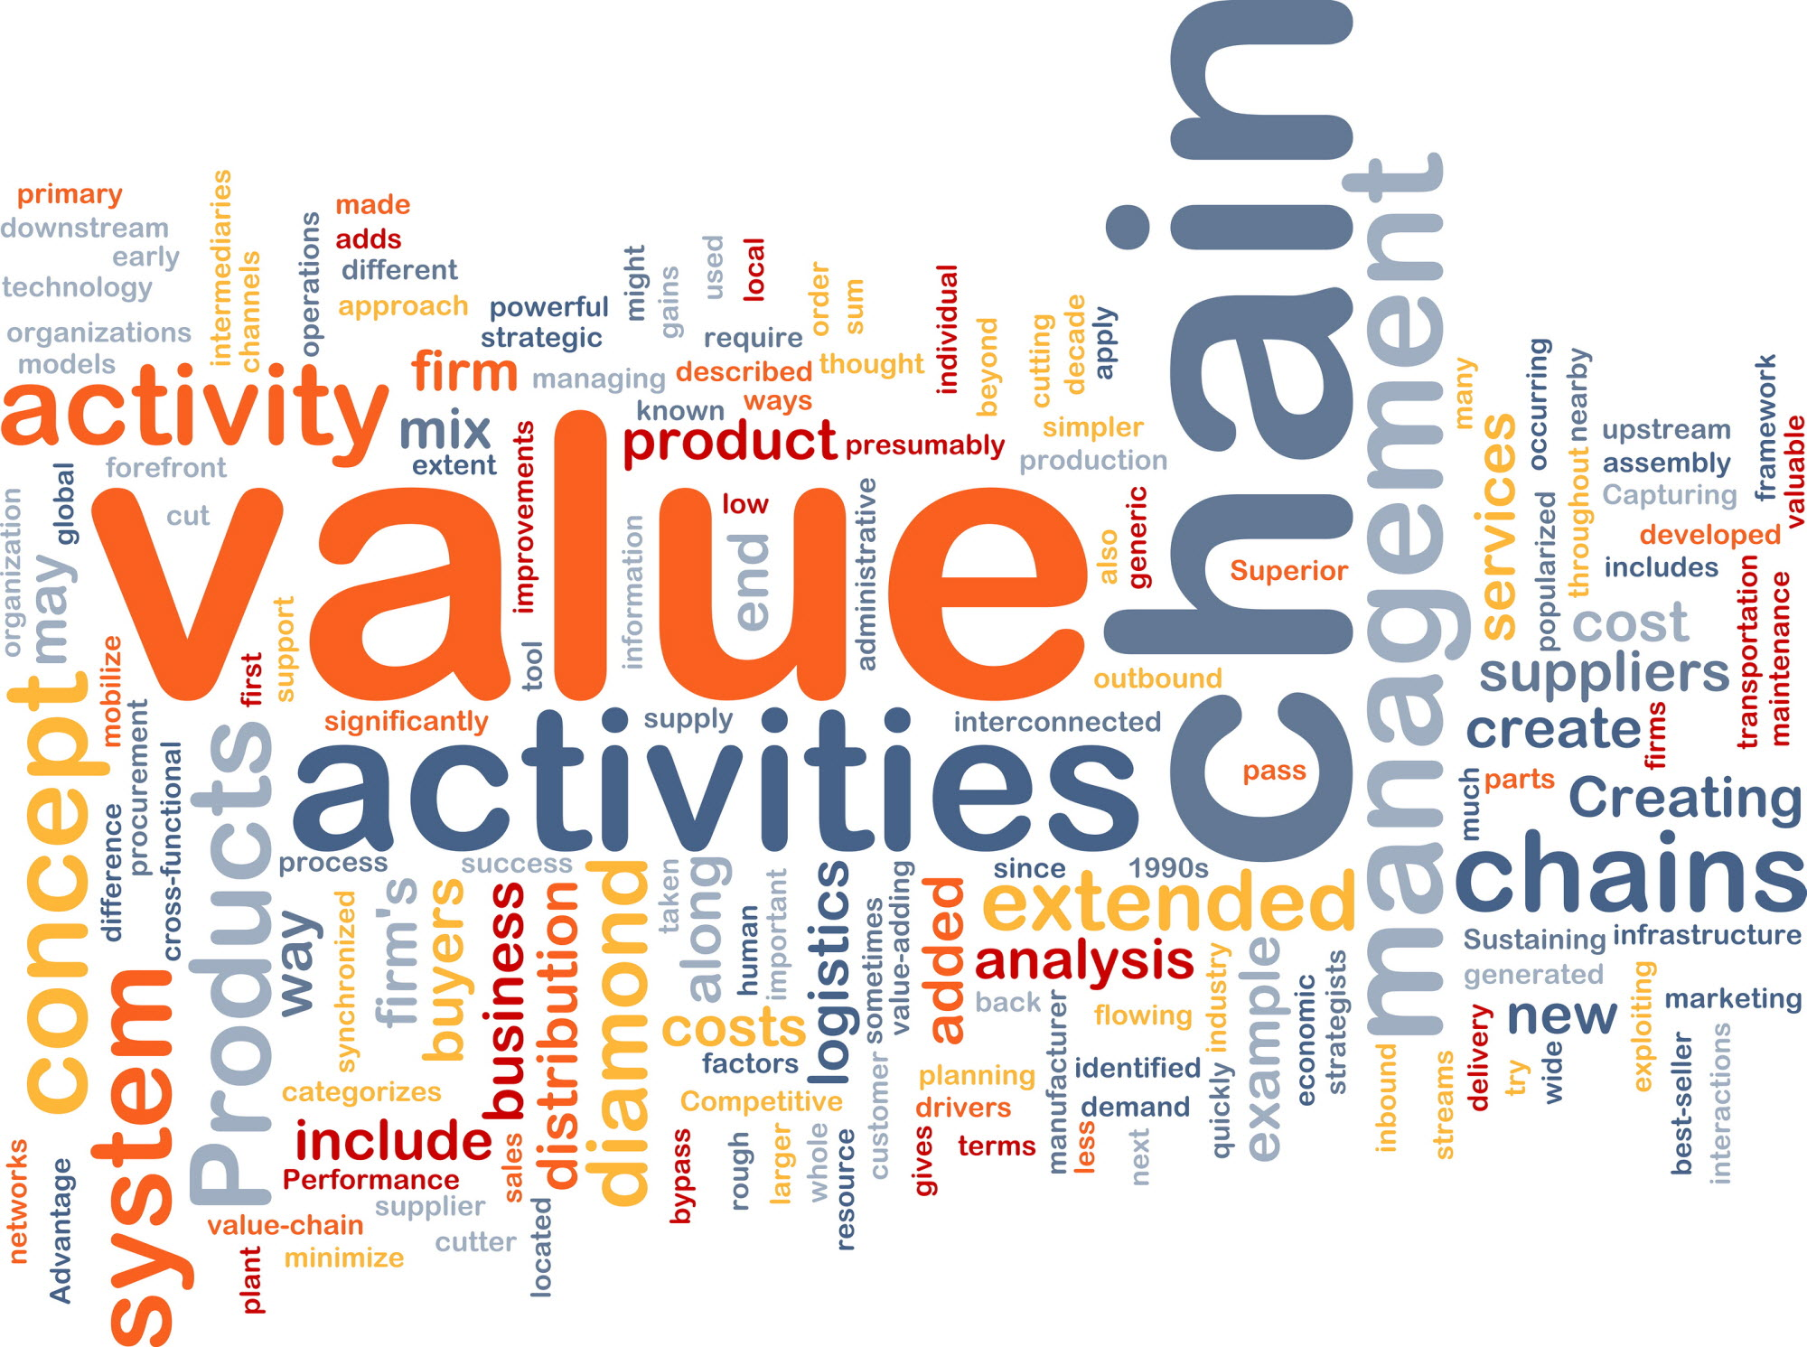
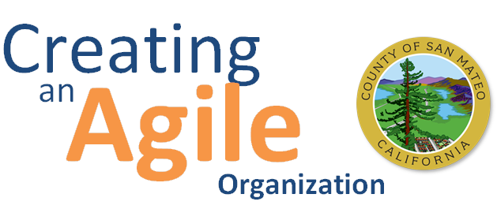
What value does standardization provide?
Consistent Modeling
Uniform Handoffs
Agile, Adaptable, Cooperative
Interoperable, Collaborative
Collaboration within
Value Chains

Slide 9
pathway to business architecture standardization
Submission of OMG standard to ISO
Formalization of business architecture discipline in BIZBOK® V1.0–4.0
Targeted timeline for OMG standard passage
2009------------------2010-----------------2011-----------------------------------2014-----------------------------2015------------------------2016--------------------2017
Early attempts to formalize metamodel – lacking formally defined discipline
Metamodel v1.0 released in BIZBOK® 4.0
RFC packaging / delivery to OMG standards process
Metamodel scenario creation, packaging
Follow-up effort to standardize business / IT architecture alignment
Note timeline is not entirely predictable due to numerous third parties involved

Slide 10
Who is driving this effort?
Business Architecture Guild Metamodel team is a collaborative team of Guild members that includes
Expert practitioners
Companies with business architecture deployments
Vendors with mutual interest in achieving business architecture standardization

Slide 11
Sample Scenarios for Testing the business architecture standard
Scenarios | Status | Available Opportunities
Shift to Customer-Centric Business Model | Open
Business Capability Outsourcing, | Open
Supply Chain Streamlining, | Open
Compliance | Open
Strategy Development and Execution | Open
Driving Requirements from Business Architecture | Open
Leveraging Business Architecture for Software Testing | In progress | Paula
Operational Cost Reduction | Open
Change Management | In progress | Janice

Slide 12
Standardization MetaModel Team Lead: Jeff Wallk
Scenario Development | Lead / Team
Driving Requirements from Business Architecture (and Software Testing) | Paula Mihalek
Shift to Customer-Centric Business Model | Paula Mihalek
Business Capability Outsourcing | Steve Hunter
Supply Chain Streamlining | Steve Hunter
Compliance | Steve Hunter
Operational Cost Reduction | Janice Lewis
Change Management | Janice Lewis
Strategy Development and Execution | Karrie Austin, Olga Romeos
Investment Analysis | OPEN
Merger and Acquisition Analysis | OPEN
New Product / Service Rollout | OPEN
Globalization | OPEN
Divestiture | OPEN
Joint Venture Development | OPEN
Glossary and Modeling Team
(Alain Picard & Jeffrey Wallk)
Publishing Team
(Alain Picard & Jeffrey Wallk)
Review Team
(Select members of Guild Board)

Slide 13
Standardization: questions / discussion
William Ulrich, Business Architecture Guild & TSG, Inc.
Janice Lewis, Pfizer
www.businessarchitectureguild.org

